Slide 1
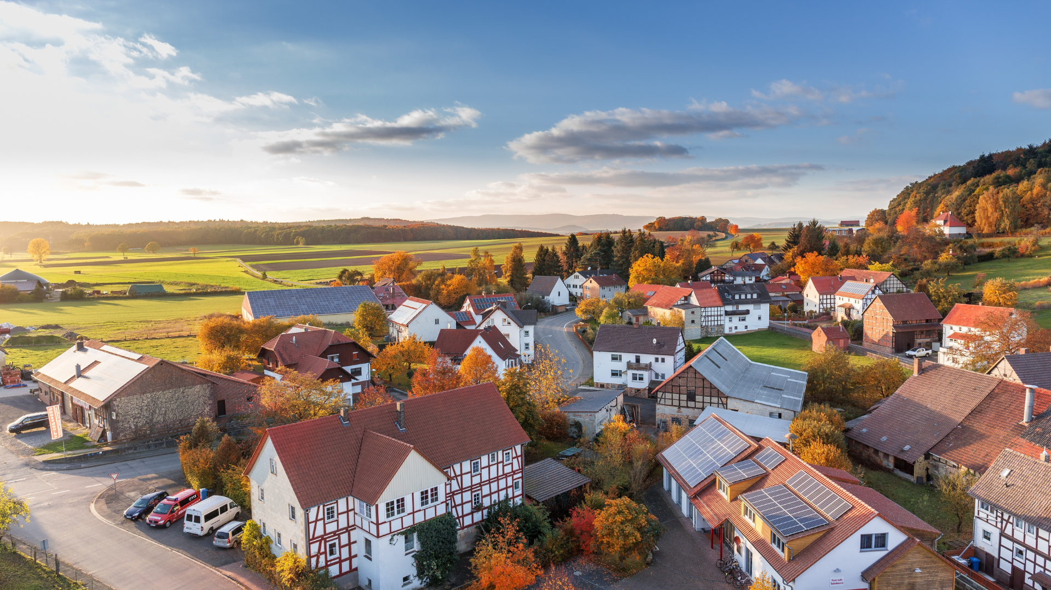

International Conference, Ravenna 9-10 November 2023
“Sustainable Development as Fundamental Pillar of
Economic Governance and Public Affairs”
RENEWABLE ENERGY COMMUNITIES
A Tool of the Enhancement of the Territory, Businesses and Citizens
Emanuela Rassu

Slide 2
“To provide environmental, economic or social community benefits for its shareholders or members or for the local areas where it operates, rather than financial profits”
RENEWABLE ENERGY COMMUNITIES
LEGAL FRAMEWORK AND ENERGY MARKET
Kyoto Protocol, Paris Agreement, AGENDA 2030 (especially GOAL 7)
European Green Deal, REPowerEU, and “Fit for 55” package
European REC Regulation
  RED II directive 2018/2001/EU
Italian REC Regulation
  Legislative Decree no. 199/2021
THE TURNING POINT
  From centralised energy production, spread out to be consumed over broad areas, to local energy production and consumption

Slide 3
“To provide environmental, economic or social community benefits for its shareholders or members or for the local areas where it operates, rather than financial profits”
RENEWABLE ENERGY COMMUNITIES
PROMOTING ENVIRONMENTAL, SOCIAL, AND GOVERNANCE SUSTAINABILITY
ESG (Environmental, Social, and Governance) rating for businesses
59,5% of manufacturing companies took sustainability actions in 2022.
Large companies are on average the most active in all sustainability practices: more than 4/5 of large companies (81.5%) and only 36.1% of small companies take sustainability actions.
Istat – “Pratiche sostenibili nelle imprese nel 2022 e nel 2023-2025”
Renewable Energy Communities and ESG
  Contribution to decarbonization
  Decrease in energy dispersion through locally monitoring energy production and consumption
  Combating energy poverty
  Ancillary activities: sustainable mobility, circular-economy actions, social welfare

Slide 4
“To provide environmental, economic or social community benefits for its shareholders or members or for the local areas where it operates, rather than financial profits”
RENEWABLE ENERGY COMMUNITIES
CHALLENGES AND PERSPECTIVES IN THE ITALIAN REGULATION
Constitutional reform introducing the environment as value and criterion of free economic activity of private individuals
Article 9
Article 41
State and Region Competences in energy production and distribution
  Article 117 of Constitution
  Constitutional Court, sentences nn. 166 and 282/2009, 11/2014, 121/2022
Administrative Law
Simplification of authorization procedures for the implementation of Renewable Energy Sources plants

Slide 5
“To provide environmental, economic or social community benefits for its shareholders or members or for the local areas where it operates, rather than financial profits”
RENEWABLE ENERGY COMMUNITIES
CHALLENGES AND PERSPECTIVES IN THE ITALIAN REGULATION
The Public Participation in Renewable Energy Communities
Expression of Orizontal Subsidiarity
Suitability of energy production within the general public interests
Observance of the regulation on Public participation into private organizations and companies

Slide 6
RENEWABLE ENERGY COMMUNITIES
THANK YOU FOR
YOUR KIND ATTENTION
International Conference, Ravenna 9-10 November 2023
A tool of the Enhancement of the Territory, Businesses and Citizens
Emanuela Rassu
PhD candidate in ‘Law and management of Sustainability’– University of Siena
E-mail: erassu110@gmail.com

